Slide 1
VIDEO-PRESENTACIÓN MIEMBRO FAMILIA
KAROLL DANIELA OVIEDO CHAVARRIA
ENGLISH DOES WORK LEVEL 1
Ficha: 2782676

Slide 2
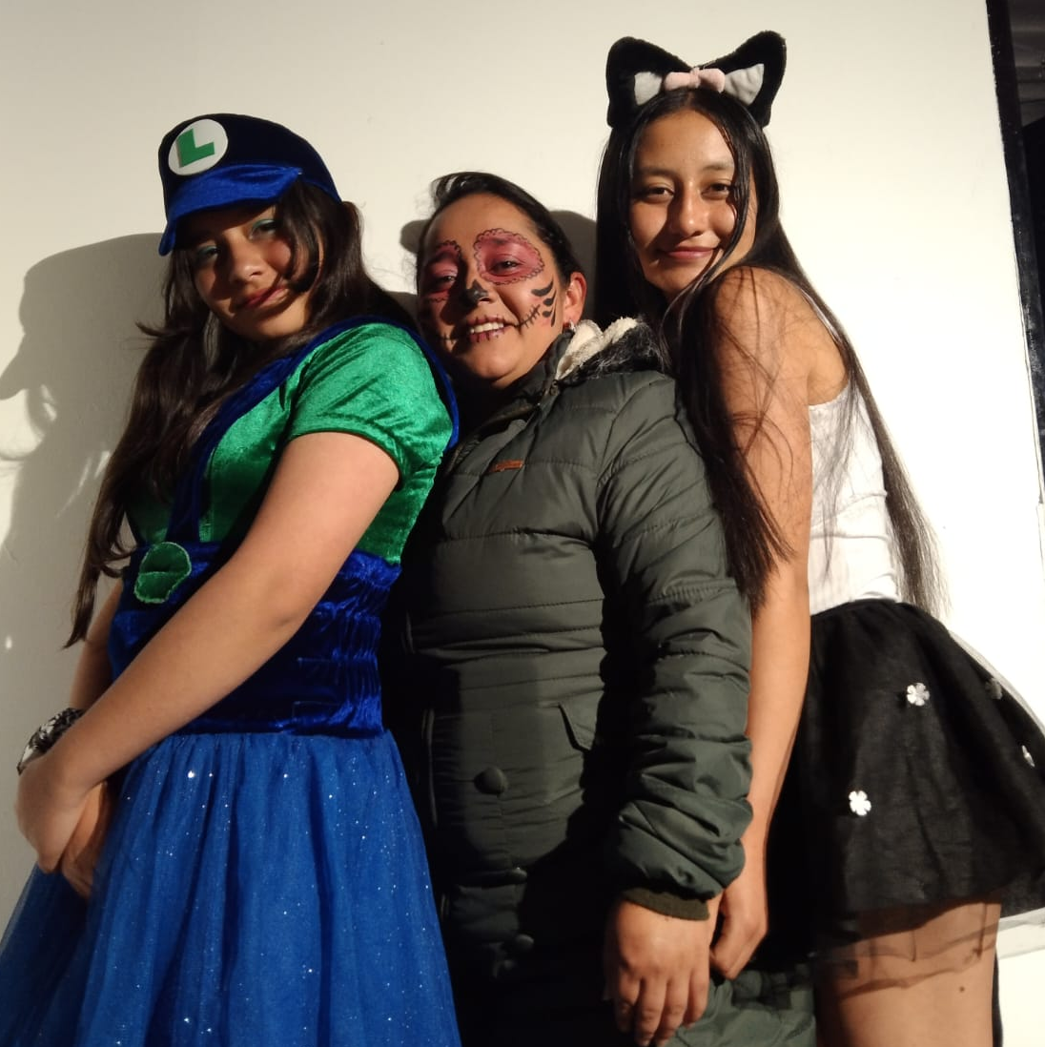
This is my family
This photo is from Halloween.
My mom Natalia Chavarria had her face painted as a catrina, a skull.
She is my sister Sofia Oviedo she is dressed as luigi with a blue skirt, a green shirt and a green cap with the letter L.
And I Karoll was dressed as a cat, wearing a black skirt, a white shirt and stuffed ears.
My sister is thirteen years old. she is a student. She was born in 2010 September 13. in her free time she reads books and plays video games and listens to music and sleep.
My mom is thirty nine years old. She is a garment worker. She was born in 1985 April 19. in her free time she prefers watching movies and reads books and exercise.

Slide 3
